Slide 1
CELL & MOLECULAR BIOLOGY FOR BIOINFORMATICS SEBB 4173 Chapter 3: DNA Transcription
Dr. Noor Hidayah

Slide 2
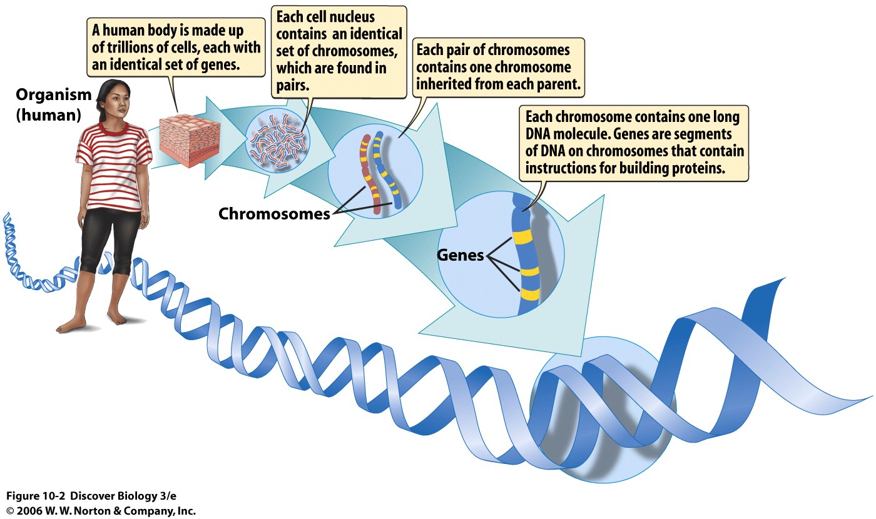

Slide 3
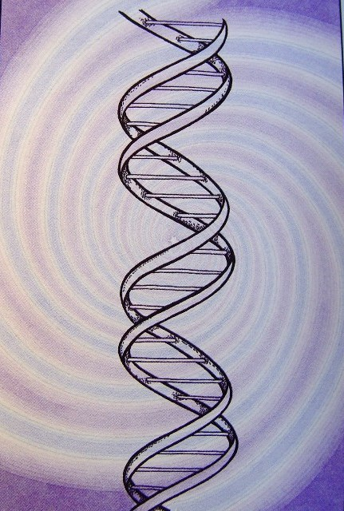
3.1 How is the Genetic Information Used?
During the day-to-day life of a cell, working copies of the genes are used.
The DNA molecule that carries the original copy of the genetic information is regarded as sacred and is not used as a direct source of instructions to run the cell.

Slide 4
3.1 How is the Genetic Information Used?
Genetic information can be carried by two kinds of molecules, DNA and RNA. The working copies of genes are made of RNA.
Do you know?: DNA and RNA have very similar chemical structures.
The particular type of RNA molecule that carries genetic information from the genes into the rest of the cell is known as messenger RNA (mRNA).

Slide 5
The transfer of information DNA ➔ mRNA: transcription!
For a gene to be transcribed, DNA must first be pulled apart temporarily. Then a molecule of single stranded RNA is made.
This is the mRNA and it has base sequence complementary to that of the DNA strand used as template.
http://www.shutterstock.com/pic-3349445/stock-photo-pulling-apart-dna.html

Slide 6
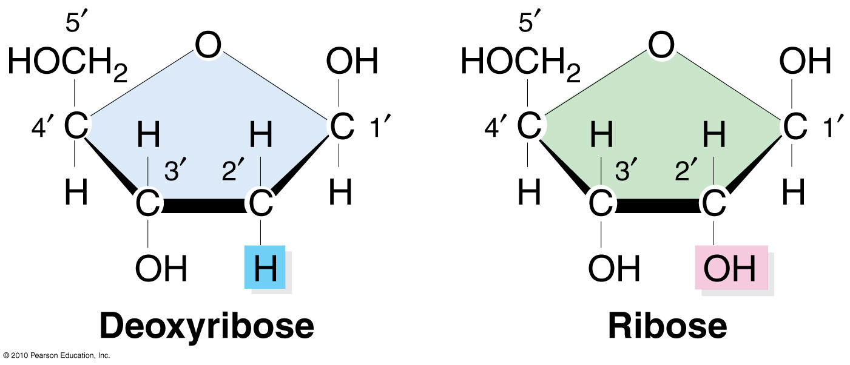
3.2 The Chemical Differences between DNA and RNA
DNA: has deoxyribose sugar,
RNA: has ribose sugar.
Deoxyribose has one less oxygen atom than ribose. It is this initial difference which gives the D in DNA versus the R in RNA.

Slide 7
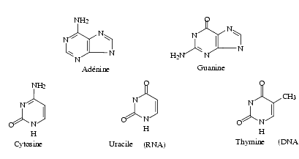
In RNA, the base thymine (T) is replaced by the closely related base uracil (U).
Uracil and thymine, convey the same genetic information.
DNA is double stranded (ds), whereas RNA is normally single stranded (ss).

Slide 8
Which strand to copy???
When a gene made of DNA is transcribed into an RNA message, only one of the strands of DNA is copied.
The sequence of the RNA message is complementary to the template strand of the DNA upon which it is synthesised.
Sequence of the new RNA molecule = sequence of the DNA (the one not actually used during transcription).

Slide 9
Short segments of the chromosome are turned into messages
Although a chromosome carries hundreds or thousands of genes, only a fraction of these are used at any given time.
In a typical bacterial cell, about 30 percent of the genes are in use at any particular time.
In the cells of higher organisms having many more genes, the proportion in use at a time is much smaller.

Slide 10
During cell growth, each gene (or small group of related genes) is used to generate a separate RNA copy when, and if it is needed.
So there are many different messenger RNA molecules!
Each of these mRNA molecules carries the information from a short segment of a chromosome.
Gene 1
Gene 2
mRNA 1
mRNA 2

Slide 11
3.3 mRNA is made by RNA Polymerase (RNAP)
Functions of RNA polymerase :
binds to the DNA at the start of a gene and
opens the double helix,
manufactures an RNA message (molecule).
3’
5’
Template strand
of DNA
RNA POLYMERASE
5’
3’
5’
3’
Non-template strand of DNA

Slide 12
Direction of synthesis
5’
3’
5’
RNA
polymerase
RNA POLYMERASE
3’
5’
3’

Slide 13
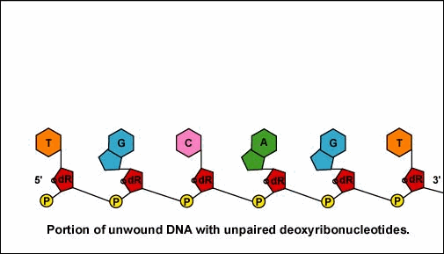
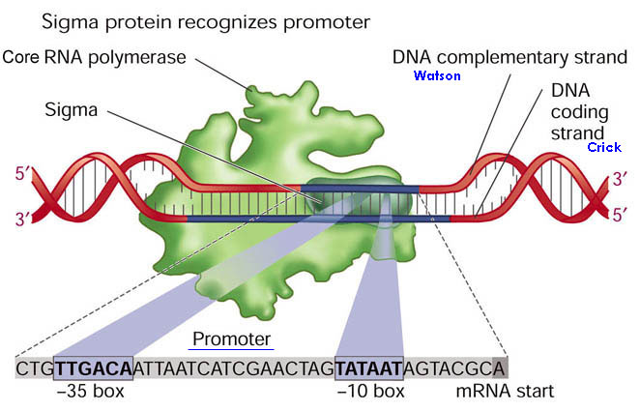
Transcription of mRNA Complementary to DNA
http://helicase.pbworks.com/w/page/17605688/Matthew-Hunter
Once the RNA polymerase/sigma factor complex recognizes the correct promoter, the sigma factor dissociate from the RNA polymerase and the enzyme begins to unwind the helix of the DNA creating a region of non-paired deoxyribonucleotides that serve as a template for RNA synthesis. Transcription is under control of the enzyme RNA polymerase.

Slide 14
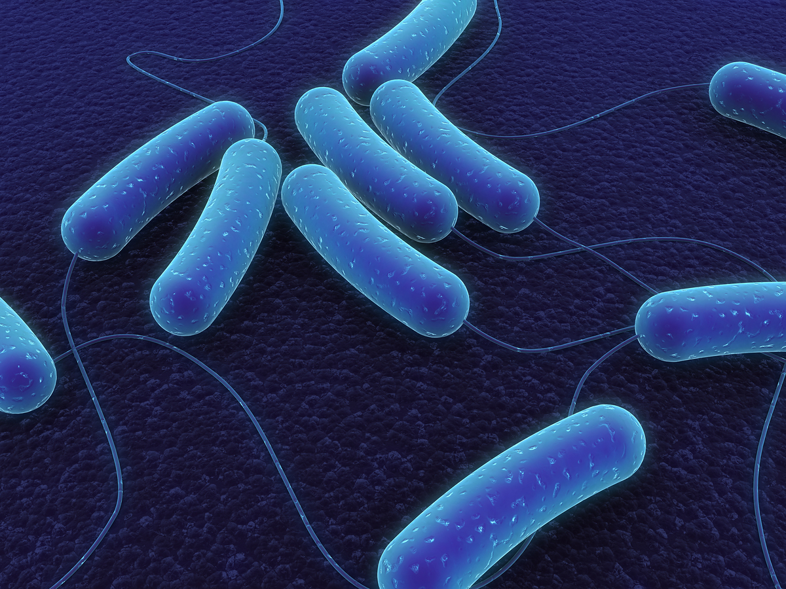
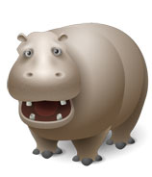
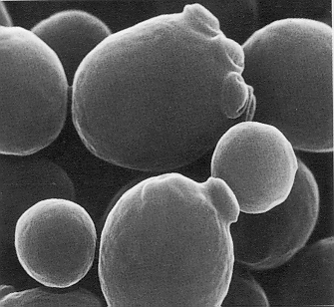
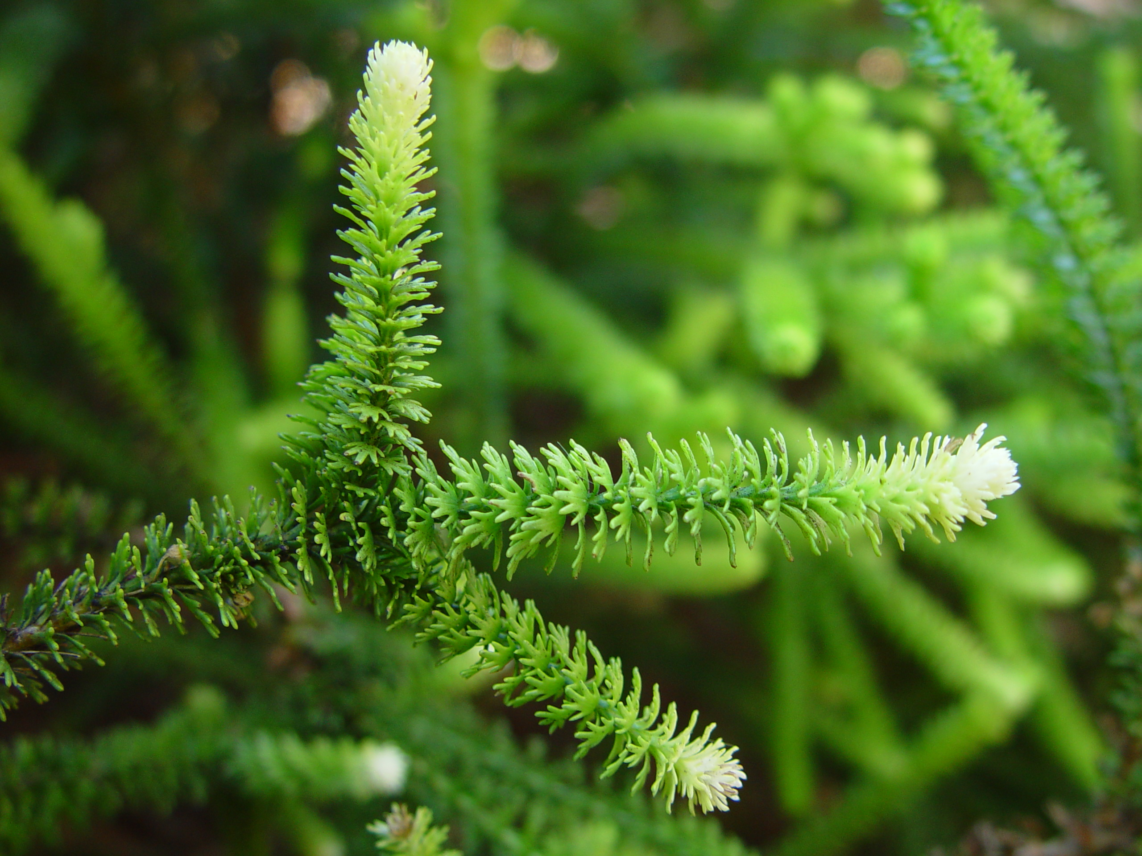
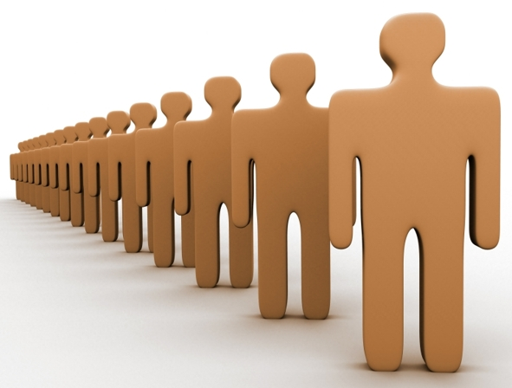
3.4 How is the Beginning of a Gene Recognised?
We will only discuss about bacteria because they're much simpler. The principles of transcription are similar in higher organisms.
http://mycor.nancy.inra.fr/blogGenomes/?tag=budding-yeast
http://humancapitaladviser.com/?p=1068
http://www.thecompletepatient.com/journal/lets-play-name-that-bacteria-handwringing-over-a-new-ecoli-o.html
http://www.turbophoto.com/Free-Stock-Images/Plants-8.htm

Slide 15
3.4.1 RNA Polymerase
RNA polymerase is made up of several protein subunits with different roles.
A special subunit of bacterial RNA polymerase, the sigma subunit recognises two special sequences of bases in the coding (non-template) sequences known as
the -10 region and
the -35 region;
(because they are found by counting backwards 10 or 35 bases from the first base of the gene).

Slide 16
upstream region
downstream region
5’
PROMOTER
gene
3’
-35 -10 +1
The stretch of DNA region front of a gene is often referred to as the upstream region and the region where RNA polymerase binds is known as the promoter.
To bind the sigma subunit properly, the base sequence needed at
-10: TATAAT
-35: TTGACA.
Such theoretically perfect sequences (in this case TATAAT and TTGACA) are known as consensus sequences.

Slide 17
CORE
RNA POLYMERASE
SIGMA
5’
3’
CODING STRAND
TTGACA
TATAAT
Consensus sequences are found by comparing many real life sequences and taking the average. In real life, a few highly expressed genes do have these exact sequences in their promoter.
In practice, the -l0 and -35 region sequences are rarely perfect. “Wrong” (not exact) by one or two bases, the sigma subunit will still recognise them.
Promoter strength depends partly on how closely matched the ideal consensus sequence.

Slide 18
3’
5’
Template strand (non-coding)
mRNA
5’
3’
Non-template strand (coding)
TTGACA
TATAAT
-35 -10
core
sigma

Slide 19
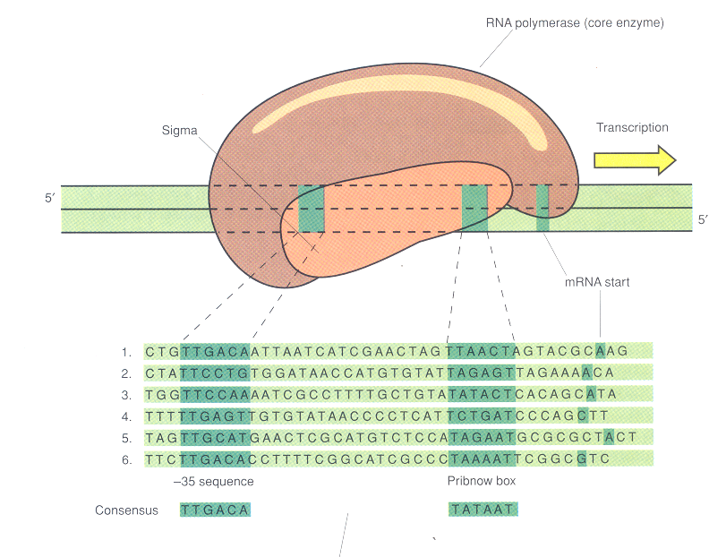
Promoter Sequences in Prokaryotes
RNA polymerase core enzyme
Sigma
Transcription
5’
3’
3’
5’
mRNA start
6 different promoter
sequences in E. coli
-35 sequence
Pribnow box or -10 sequence
Consensus

Slide 20
3.5 Manufacturing the Message
Once sigma has found a promoter and the RNA polymerase has successfully bound to it, the sigma subunit drops off. The remaining part of bacterial RNA polymerase (core enzyme) then makes the mRNA.
The DNA double helix is opened up and a single strand of RNA is generated using one of the DNA strands as a template.

Slide 21
3’
5’
Template strand
(non-coding)
RNA POLYMERASE
mRNA being synthesized
5’
3’
Non-template strand (coding)
5’
3’

Slide 22
G
T
3’
A
5’
Non-coding Strand (template)
C
A
T
G
A
C
G
T
T
A
C
mRNA is synthesised
G
C
Coding Strand (non-template)
A
C
U
G
C
A
A
U
G
G
5’
5’
3’
G
3’
T
C
A

Slide 23

3.6 How Does RNAP Know Where to Stop?
Just as there is a special recognition site at the FRONT of each gene, there is a special sequence at the END.
A terminator sequence consists of two inverted repeats separated by several bases followed by a string of As (in the template strand of the DNA).

Slide 24
Termination Recognition
Inverted
Repeats
DNA
>>>>>>>>>
Non-Template ATTA – TAGCGGCCATC – ACTGTTACA – GATGGCCGCTA – TTTTTT
Template TAAT – ATCGCCGGTAG – TGACAATGT – CTACCGGCGAT – AAAAAA
<<<<<<<<<
TRANSCRIPTION
>>>>>>>>> <<<<<<<<<
5’
3’
mRNA AUUA – UAGCGGCCAUC – ACUGUUACA- GAUGGCCGCUA-UUUUUU
The two inverted repeat sequences are actually on opposite strands of the DNA. The sequence of the mRNA will be the same as the non-template strand of DNA except for the substitution of U for T.

Slide 25
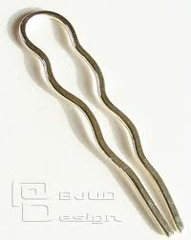
“Inverted repeats" = The second "repeat" is the complement of the inverse of the first (???).
Because of this, the sequences on the same strand of an RNA molecule can pair up to generate a “stem and loop” or “hairpin” structure.

Slide 26
Inverted Repeats Make a Stem and a Loop
G
U
U
Loop :
Unpaired bases
U
A
C
C
C
A
A
CUACCGGCGAU
GAUGGCCGCUA
Stem :
(base pairing between the inverted repeats
terminator
Messenger RNA ^{5’-}AUUA’
‘UUUUUU---3’ end

Slide 27
stem
loop
stem
mRNA AUUA – UAGCGGCCAUC – ACUGUUACA- GAUGGCCGCUA-UUUUUU
FOLDS
G
U
U
U
A
C
C
A
A
CUACCGGCGAU
GAUGGCCGCUA
stem
stem

Slide 28
The string of As in the DNA ➔ a run of Us at the 3' end of the mRNA. Once the RNA polymerase reaches the stem and loop it stops.
Long RNA molecules contain lots of possible hairpin structures which cause RNA polymerase to slow down or stop briefly, depending on the size of the hairpin.
This provides an opportunity for termination but, if there is no string of Us, the RNA polymerase will start off again!

Slide 29
How does it stop?
A string of Us paired with a string of As in the template strand of DNA is a very weak structure and the RNA and DNA just fall apart while the RNA polymerase is idling.
Once the DNA and RNA have separated at the terminator structure the RNA polymerase falls off and wanders away to find another gene.

Slide 30
mRNA
AAAAAAA
UUUUUUU
DNA template strand
RNA polymerase
disassembly
AAAAAAA
UUUUUUU
DNA template strand

Slide 31
3.7 How Does the Cell Know Which Genes to Turn On?
Although each gene has a promoter and a terminator for starting and finishing the synthesis of messenger RNA, this still does not tell us when to turn on a gene.
Some genes are switched ON all the time. They are sometimes known as housekeeping genes and they are said to be expressed constitutively. Most of them have both their -10 and -35 promoter region sequences very close or identical to consensus.

Slide 32
They are always recognised by the sigma subunit of RNA polymerase and are switched ON automatically under all conditions.
Genes which are only needed under certain conditions usually have poor recognition sequences in the -10 and -35 regions of their promoters.
In that cases the promoter sequence is not recognised by the sigma subunit unless another accessory protein is there to help.
- gene activator protein. Different for different genes.

Slide 33
Activator protein binds first then helps RNA polymerase bind
RNA polymerase
Genes to be
transcribed
-35 -10 +1

Slide 34
Each activator protein may recognise one or more genes.
A group of genes which are all recognised by the same activator protein will be expressed together under similar conditions, even if the genes are at different places on the DNA.

Slide 35
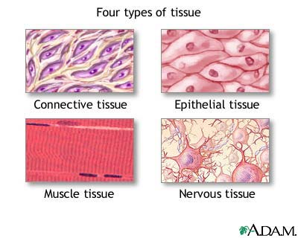
Higher organisms have many genes which are often expressed differently in different tissues.
As a result, eukaryotic genes are often controlled by multiple activator proteins also known as transcription factors.
So for now we'll stick to bacterial genes as examples!
http://nursingcrib.com/anatomy-and-physiology/anatomy-and-physiology-tissues/

Slide 36
What Activates the Activator?
In living cells, especially in more complex higher organisms, there may indeed be a series of regulators, each regulating the next.
Ultimately, however, the cell must respond to some outside influence.

Slide 37
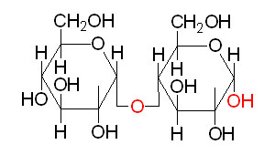
3.8 Activator
As a simple example of an activator, let's consider the use of maltose in E. coli.
Maltose is a sugar made originally from the starch in malt. E. coli can grow using this sugar to satisfy all of its needs for energy.
Maltose?

Slide 38
3.8.1 MalT Activator Protein
An activator protein (MalT), detects maltose by binding to it. The MalT protein changes shape when it binds maltose.
The original "empty" form of MalT cannot bind to DNA.
The active form (MalT + maltose) can bind to DNA and it finds the genes needed for growth on maltose and activates them. So the genes intended for using maltose are only expressed when this particular sugar is available.
The same general principle applies to most nutrients although the details of the regulation often vary from case to case.

Slide 39
Maltose
MalT binds
Maltose and changes shape
MalT site
PROMOTER
GENE
-35 -10 +1
5’
mRNA
3’
RNA polymerase

Slide 40
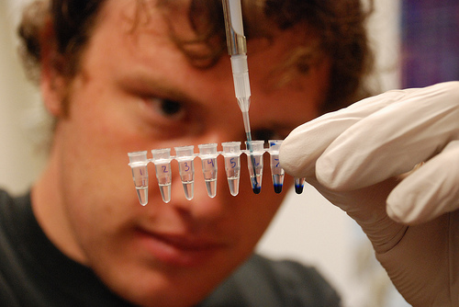
3.9 Negative Regulation
Just as there are activator proteins which help turn genes ON, there also proteins that can turn genes OFF!
Historically, these negative regulators are actually discovered first. They are known as repressors and they work in a similar way to activators except they have the opposite effect.
http://2011.igem.org/Team:UC_Davis/Notebook/Week_7

Slide 41
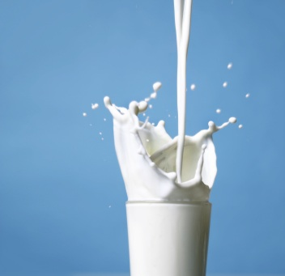
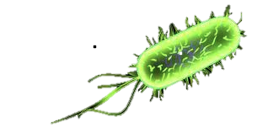
The best known example is the lactose repressor (the Lacl protein).
Lactose is a sugar found in milk, which E. coli can grow on too.

Slide 42
3.9.1 LacI Repressor
lactose
Empty LacI in
operator site
Conformation changes and inactive LacI falls off
RNA polymerase binds
Lac I
-35 -10 -5 +1
OPERATOR
RNA polymerase
promoter

Slide 43
When there is no lactose….
If no Iactose is available the Lacl protein binds to the stretch of DNA between the promoter and the genes for using lactose.
The site where a repressor binds is called the operator sequence.
The repressor blocks the binding of RNA polymerase, simply by getting in the way.
When Iactose is present it will bind to the Lacl protein. The Lacl protein then changes shape and falls off the DNA!

Slide 44
Now the RNA polymerase can bind, and the genes for using lactose are switched ON.
The overall result is the same as for maltose: when lactose is available, the genes for using it are switched on and when there is no lactose, the genes are turned off.
LACTOSE ✔ ➔ GENE ON
LACTOSE ✖ ➔ GENE OFF

Slide 45
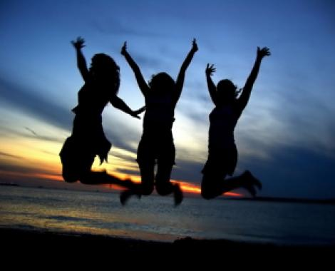
End of Chapter 3!

